Slide 1
IBS754
Tim Read
DNA Sequencing Technologies

Slide 2
Plan
Lecture
Sequencing technology and data
Exercise (if time)
Analyzing sequence data using FastQC

Slide 3
Genomics = Technology
It is very important to understand the basis of the technology that generates the raw data
This technology changes very rapidly – you need to check back at least every six months
Keep an eye out for new emerging technologies that may deliver interesting new data types

Slide 4
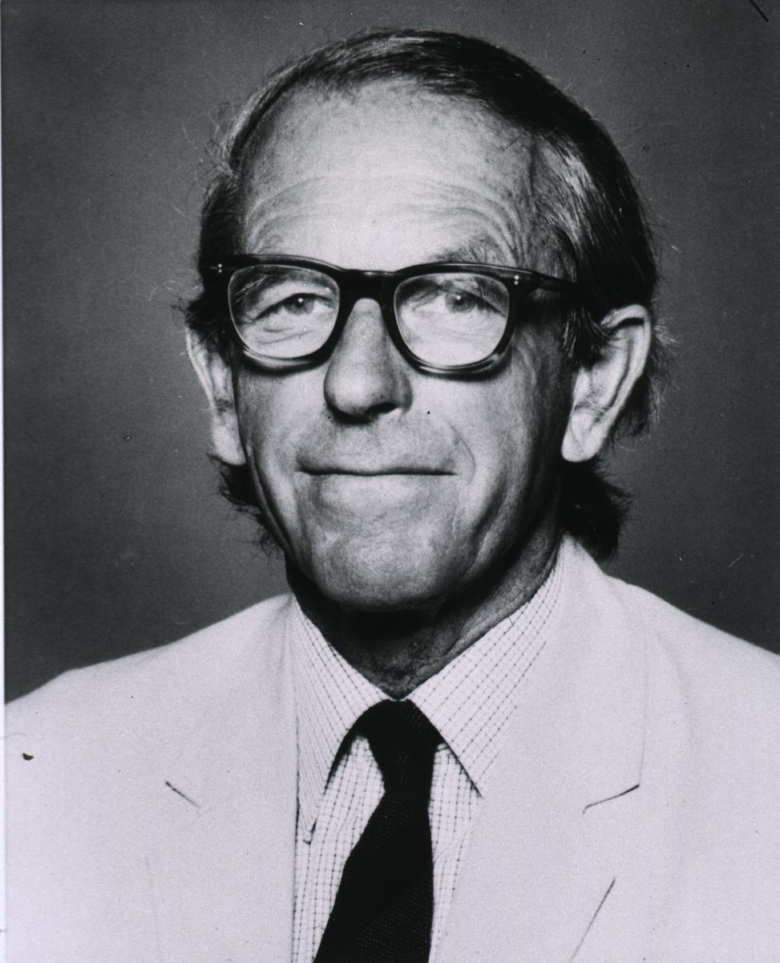
DNA Sequencing History (I)
1973: Gilbert & Maxam publish DNA sequence by chemical cleavage
1977: Fred Sanger’s chain termination method
1979: First genome – phiX174
1986: ABI releases automated sequencer using fluorescent dyes
http://www.nlm.nih.gov/visibleproofs/media/gallery/vi_a_208b.jpg

Slide 5
DNA Sequencing History (II)
1995: First free living organism genome :
H. influenzae
1998: ABI releases capillary electrophoresis instrument
2003: Human genome completed (mostly)

Slide 6
DNA Sequencing History (III)
2005: 454 Unveils the GS-20 – the first commercial ‘next generation’ sequencer.
2006: Commercial release of the Solexa (later Illumina, GA1)
2009: Illumina GAII used to find mutations between healthy and cancer tissue tissue in a single patient.
2010: pacBio releases first single-molecule sequencer
2012: Oxford Nanopore demonstrates “laptop sequencer”
2015: Plans announced for “one million human genome” project

Slide 7
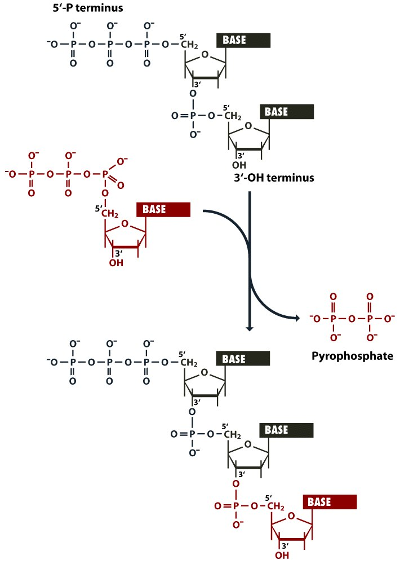
Figure 1.6 From Brown Genomes 3 (© Garland Science 2007) No redistribution outside AHPL servers without publishers permission.

Slide 8
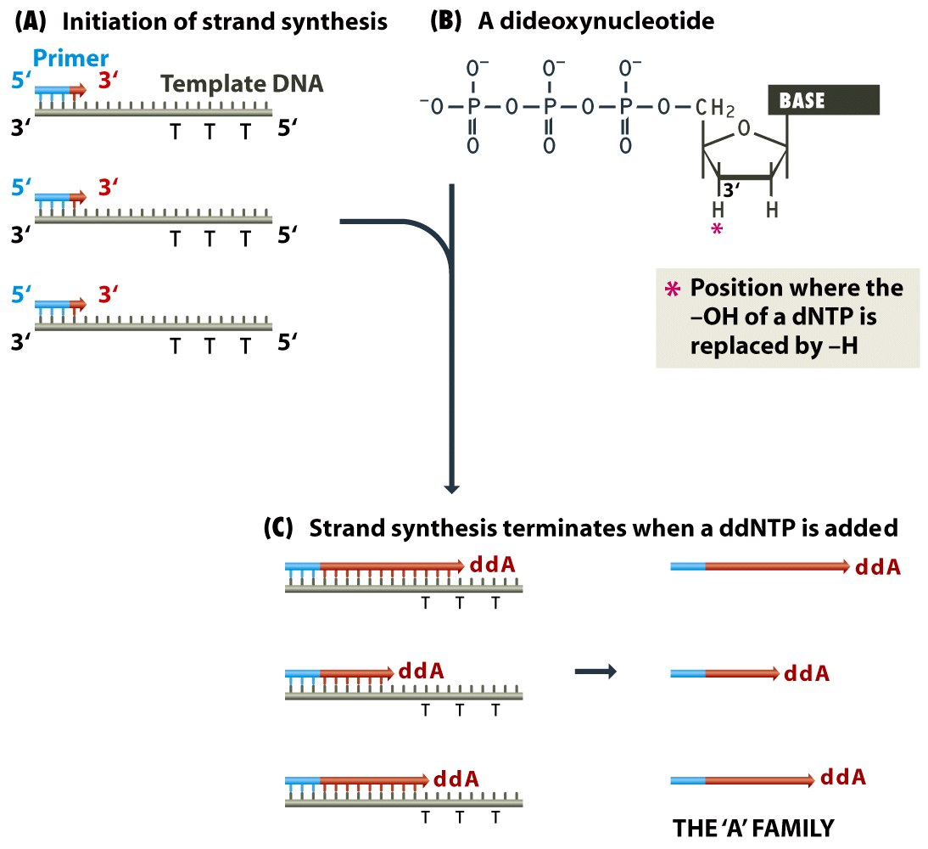
From: Brown, Figure 4.2 Genomes 3 (© Garland Science 2007). No redistribution outside AHPL servers without publishers permission.

Slide 9
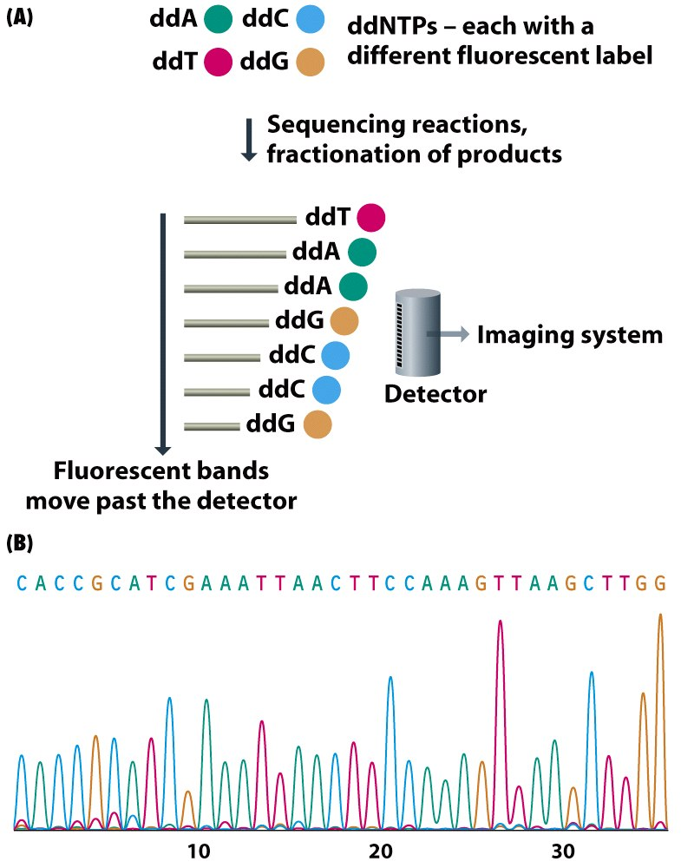
From: Brown, Figure 4.3 Genomes 3 (© Garland Science 2007). No redistribution outside AHPL servers without publishers permission.

Slide 10
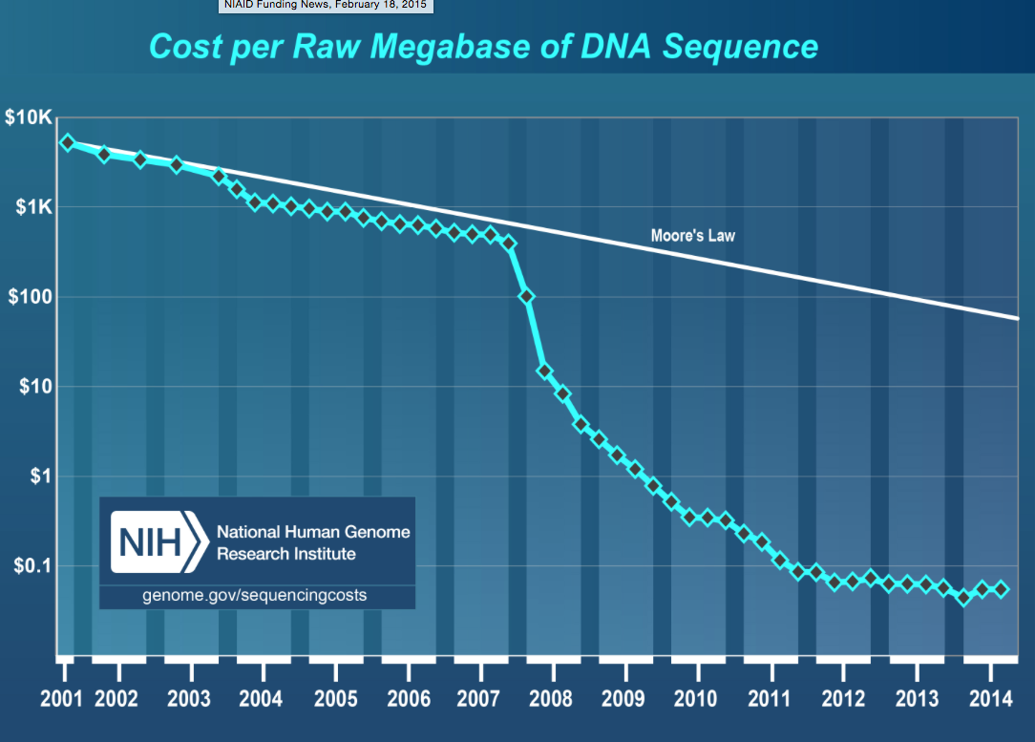

Slide 11
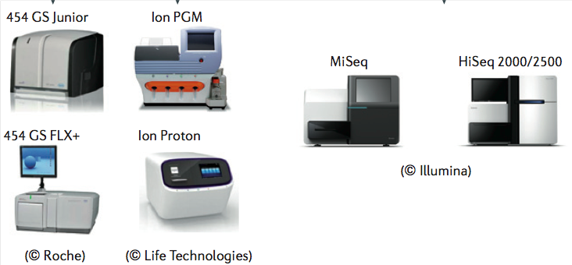
1st versus 2nd generation sequencing
1st generation: One tube = 1 sequence
2nd generation: One tube = millions of sequences

Slide 12
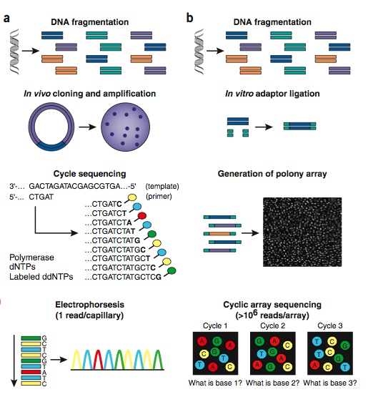

Slide 13
Pyrosequencing
Sulfurylase
PPi released from
nucleotide extension
APS+PPi
ATP
luciferin
oxyluciferin
Luciferase
ATP
Light

Slide 14
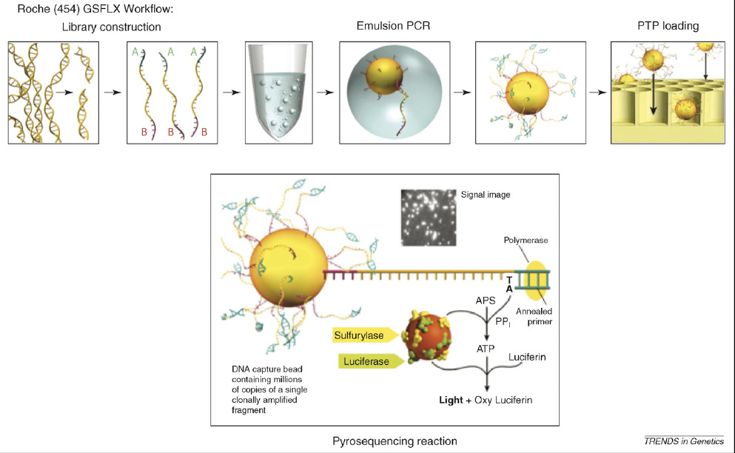
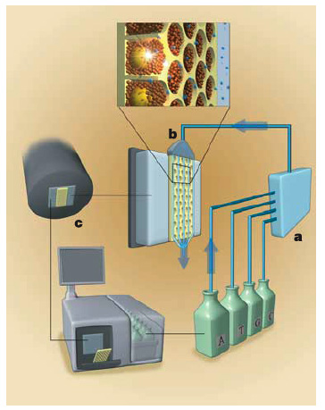
Next Generation Sequencing
Pyrosequencing
ER Mardis Trends in Genetics, 2008, 24(3):142-149
Margulies et al Nature. 2005 437(7057):376-80

Slide 15
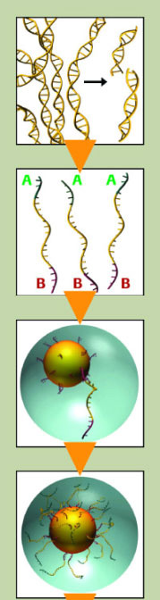
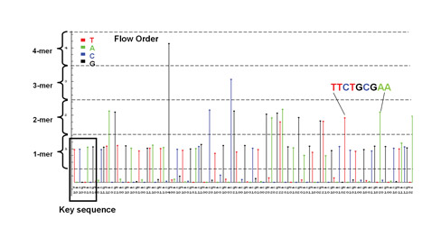
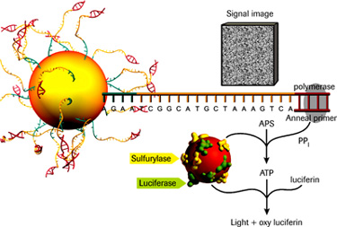
454: high throughput pyrosequencing by synthesis

Slide 16
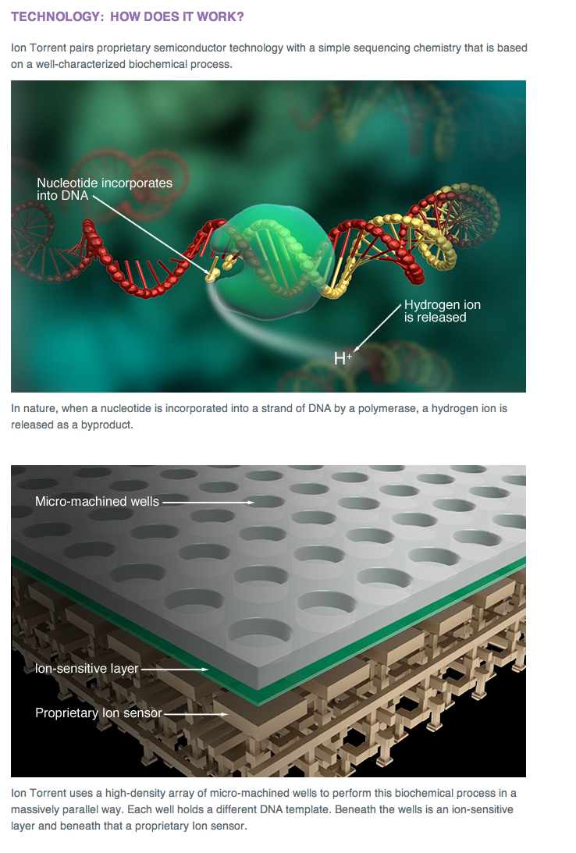
Ion Torrent

Slide 17
Ion Torrent
https://www.youtube.com/watch?v=WYBzbxIfuKs
Semiconductor sequencing – no cameras
Same problems as the 454 – homopolymers
Reads not as long as PacBio
Cost per Mbase not as low as Illumina

Slide 18
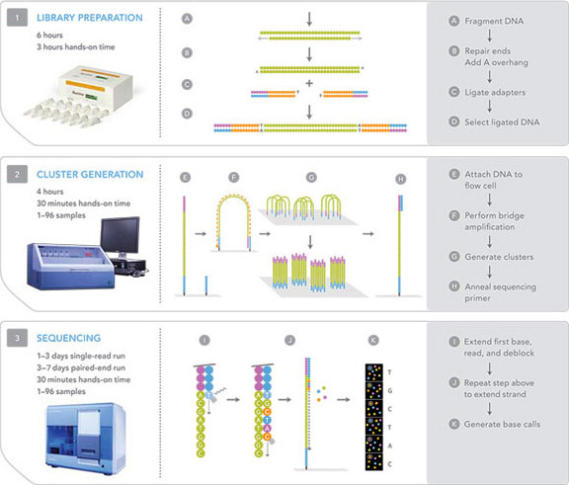
Illumina sequencing using reversible terminators

Slide 19
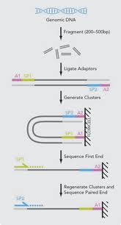
Paired end sequencing

Slide 20
Illumina video
https://www.youtube.com/watch?v=HMyCqWhwB8E

Slide 21
Complete Genomics
Very high throughput second generation technologies
Only sequences a limited number of mammalian genomes
By service only (doesn’t sell instruments)
Data interprstation is complex

Slide 22
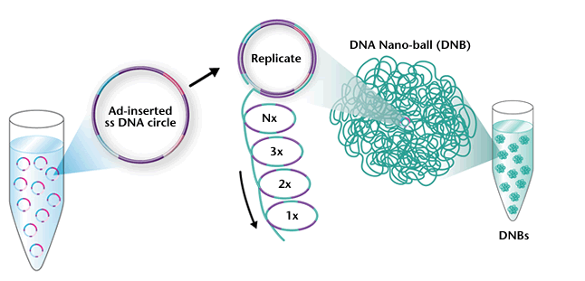
DNA nanoballs

Slide 23
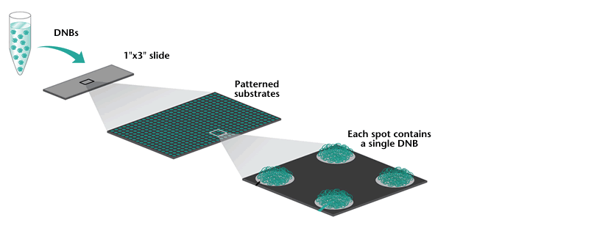
DNBs onto array

Slide 24
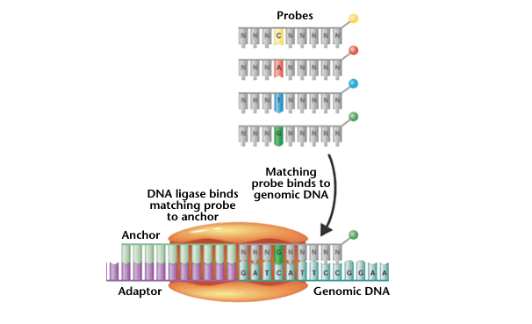
Ligase based sequencing

Slide 25
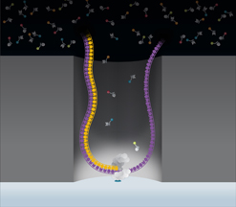
Pacific Biosciences (2011)
Observable volume

Slide 26
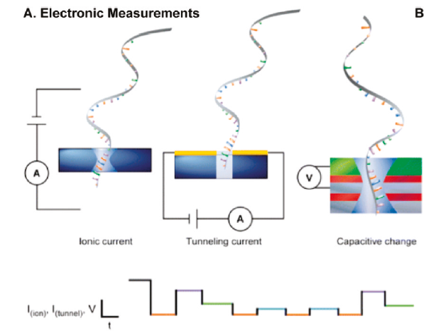
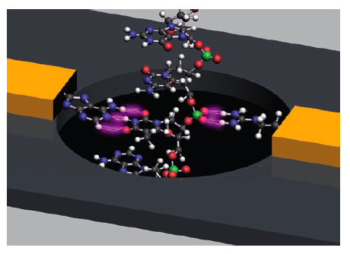
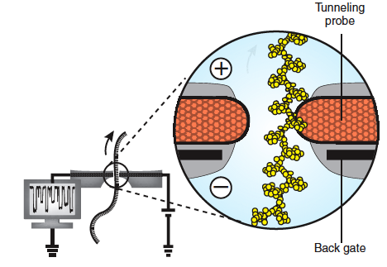
Nanopore Sequencing
Anal Chem. 2011 83(12):4327-41.
Potential: High speed, long > 25kb reads, low cost (no enzymes)
Challenges remain: slow down DNA translocation from μsec to msec, pore stability, stochastic motion of DNA molecule, noise, sensitivity
Nat Biotechnol. 2008 26(10):1146-53

Slide 27
PacBio Video
http://www.youtube.com/watch?v=NHCJ8PtYCFc

Slide 28
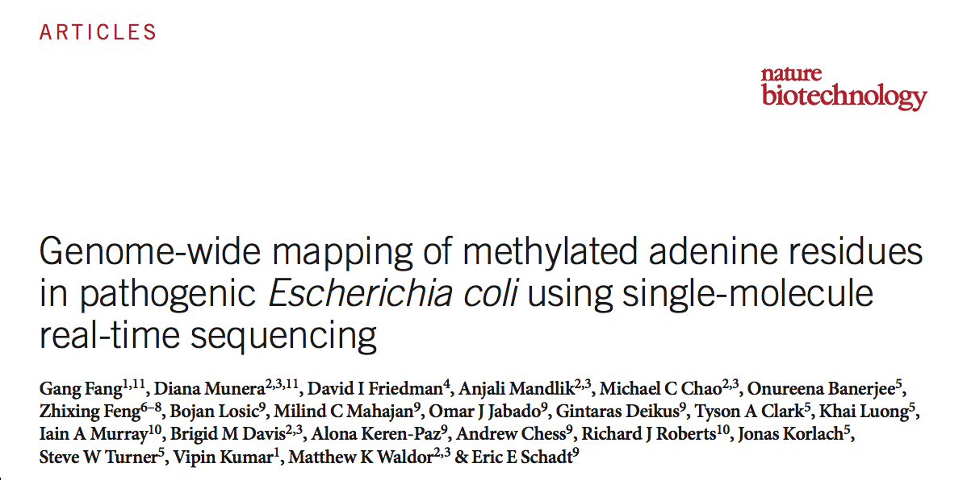
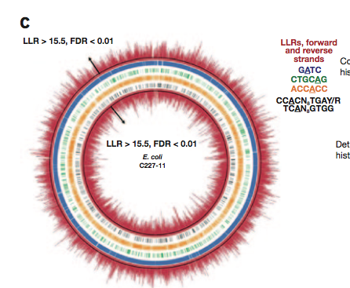
New Approaches: Hypothesis free detection of DNA modification using PacBio
Adenine methylation map of an E. coli

Slide 29
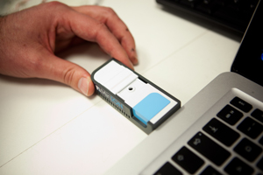
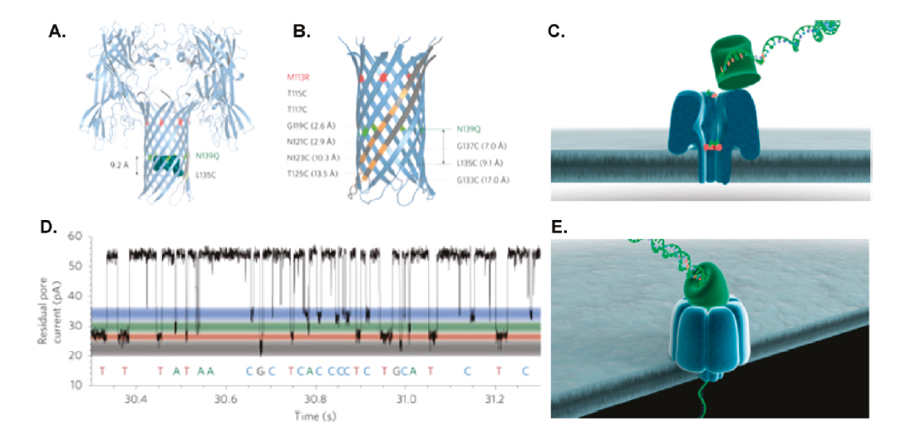
Oxford Nanopore MiniION
GridION – Complete Genome < 1hr
Anal Chem. 2011 83(12):4327-41.

Slide 30
Oxford nanopore video
https://www.nanoporetech.com/technology/analytes-and-applications-dna-rna-proteins/dna-an-introduction-to-nanopore-sequencing

Slide 31
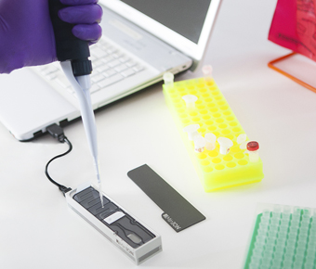
Laptop sequencing
Oxford Nanopore MinIon

Slide 32
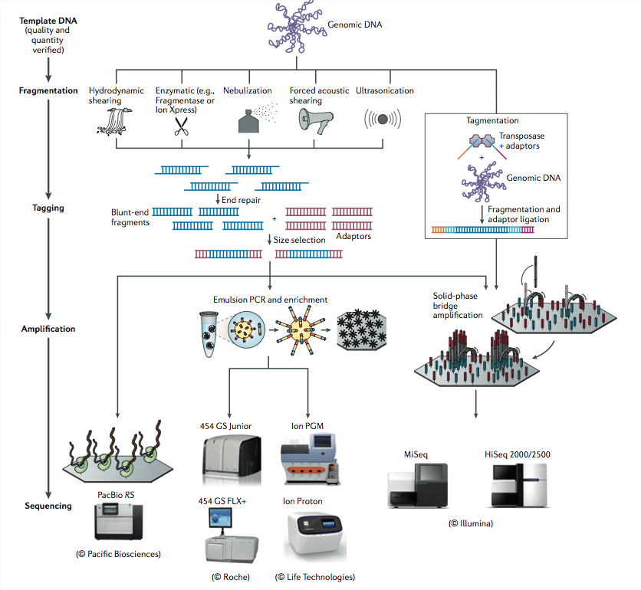
Summary
1.Loman, N. J. et al. High-throughput bacterial genome sequencing: an embarrassment of choice, a world of opportunity. Nat Rev Microbiol 10, 599–606 (2012).

Slide 33
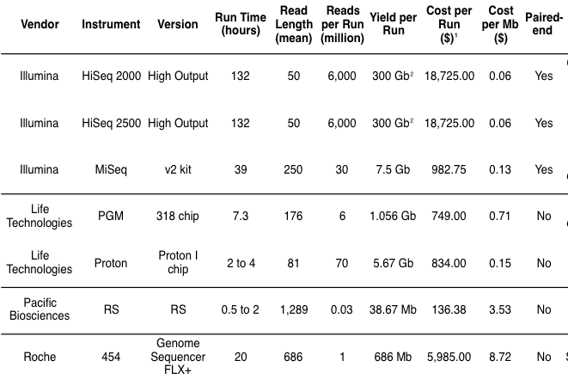
Some 2015 comparisons
Chris Mason

Slide 34
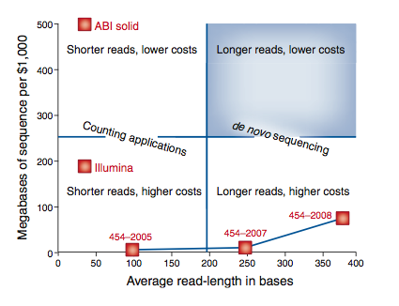
Nextgen technologies
Third generation?
The formula is not as simple as cost per base. Shorter and/or lower quality reads are less useable for data analysis.

Slide 35
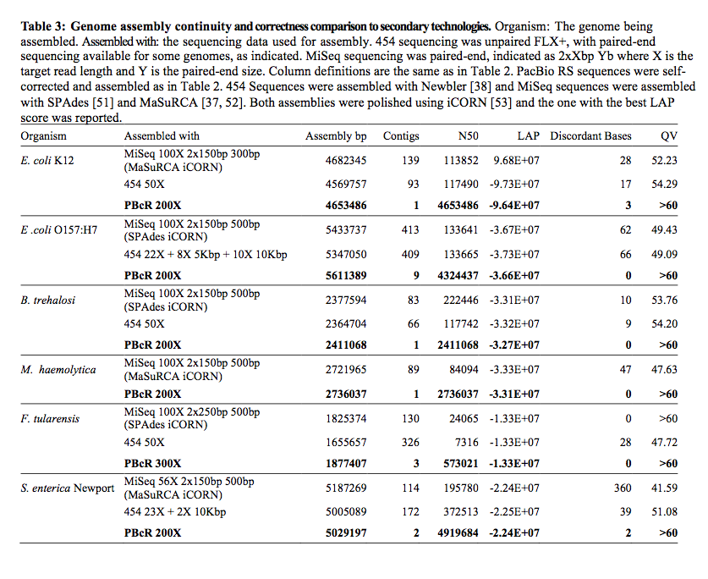

Slide 36
Hype and anti-hype
New technologies usually are announced with “this-changes-everything” hype from the company
Then, shortly after release comes a backlash as expectations are not met
Most new sequencing products released the last 10 years have failed
Most successful technologies have looked really bad for the first few months/ years after launch before they succeed

Slide 37
How can you tell?
One reasonable guide is the a new product offers a useful specification (read length, cost, size, speed etc) at the outset that is far beyond the current state-of-the-art

Slide 38
Quality Scores
Phred software estimates error rate based on electropherogram (Ewing et al. 1998).
Linked error probability (P) to electropherogram curve size, shape
Q = [ − 10.log₁₀(P)].
Therefore a Q score of 20 has a 1 in 100 chance of being incorrect.

Slide 39
FastQ
The standard format for storing sequence data
Very large text file
WARNING – at least 2 common variations on the format

Slide 40
FastQ format
Each sequence comprises 4 lines
@SRR001666.1 071112_SLXA-EAS1_s_7:5:1:817:345 length=36
GGGTGATGGCCGCTGCCGATGGCGTCAAATCCCACC
+SRR001666.1 071112_SLXA-EAS1_s_7:5:1:817:345 length=36
IIIIIIIIIIIIIIIIIIIIIIIIIIIIII9IG9IC

Slide 41
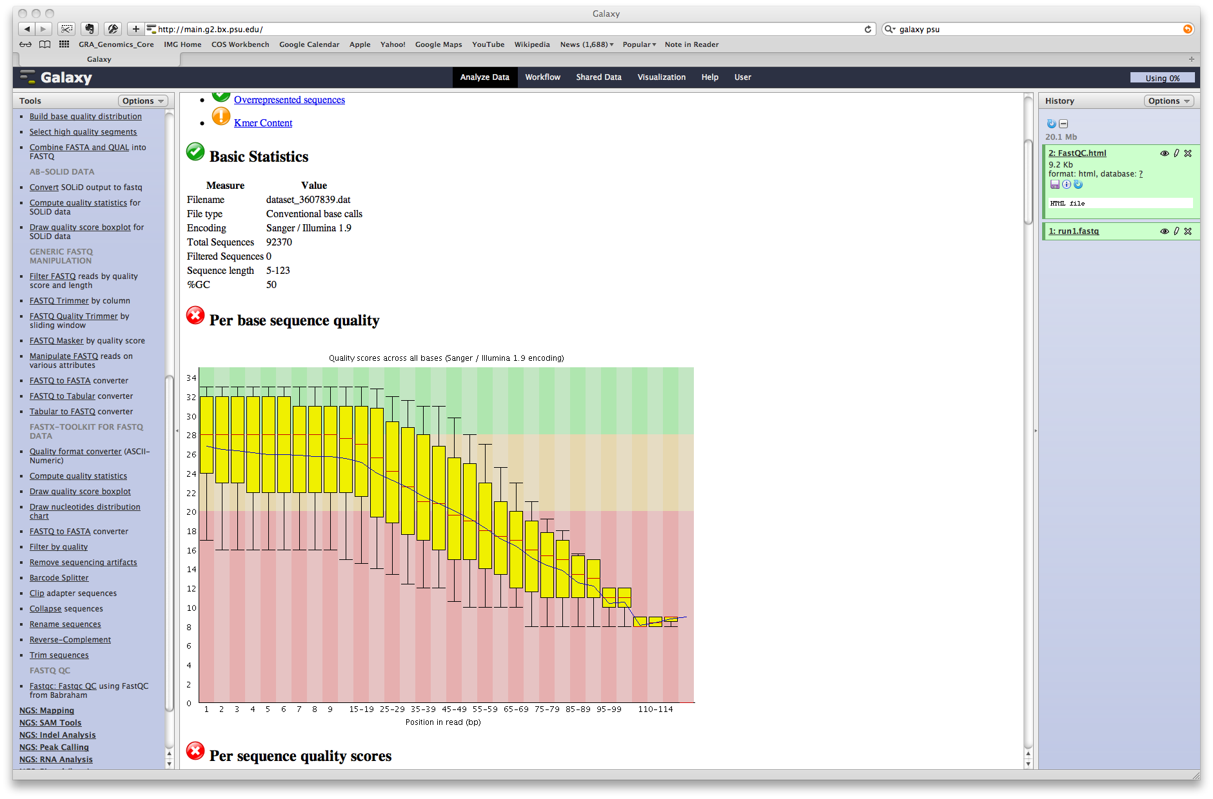
FastQC
JAVA program for graphical analysis of sequence data

Slide 42
Exercise
Create a Galaxy Account if you don’t have one already
Go to .. https://main.g2.bx.psu.edu/u/timread01/h/unnamed-history
Use “Import History” to import these data into your account

Slide 43
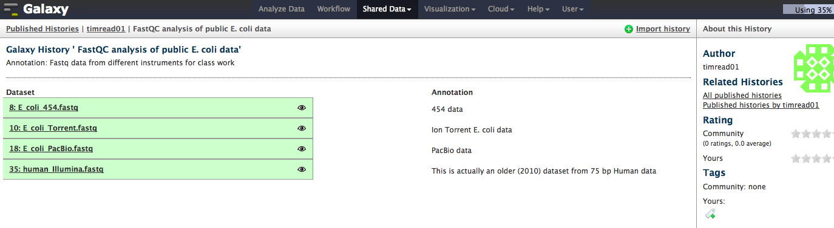
Insert History

Slide 44
Find the fastqc command on the left hand side using a search command.
Run on each of the FastQ format files
Note the differences in profile for each technology

